Slide 1
^{Chapter 5} Tree
ZAMAN UNIVERSITY
Data Structures and Algorithms

Slide 2
Outline
Binary Trees
Traversing Binary Tree
Red-Black Trees
Red-Black Tree Insertions
2-3-4 Trees

Slide 3
Outline
Binary Trees
Traversing Binary Tree
Red-Black Trees
Red-Black Tree Insertions
2-3-4 Trees

Slide 4
Red-Black Tree Characteristics
Red-Black Tree Characteristics:
The nodes are colored;
During insertion and deletion, rules are followed.
Colored nodes, in Red-Black tree every node is either red or black.
Red-Black rules:
1. Every node is either red or black.
2. The root is always black.
3. If a node is red, its children must be black.
4. Every path from the root to a leaf, or to a null child, must contain the same number of black nodes.

Slide 5
The Actions
There are two actions to make Red-Black tree balancing:
Recolor (Change Color)
Rotations.
Try red-black tree on https://www.cs.usfca.edu/~galles/visualization/RedBlack.html

Slide 6
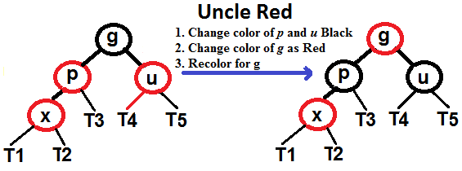
Red-Black Insertion Procedure
Please note that color of NULL node is BLACK
Suppose, x is a new node to be inserted.
1. Perform Binary Search Tree to new inserted node, and color it RED
2. if x is root, change color of x as BLACK
3. Do following if color of x’s parent is RED and x is not root
a. if x’s uncle is RED
i. change color of parent and uncle as BLACK.
ii. color of grand parent as RED.
iii. Change x = x’s grandparent, repeat steps 2 and 3 for new x.

Slide 7
Red-Black Insertion Procedure (cont.)
b. if x’s uncle is BLACK
i. Left Left (p is left child of g and x is left child of p).
ii. Left Right (p is left child of g and x is right child of p).
iii. Right Right (p is right child of g and x is right child of p).
iv. Right Left (p is right child of g and x is left child of p).

Slide 8
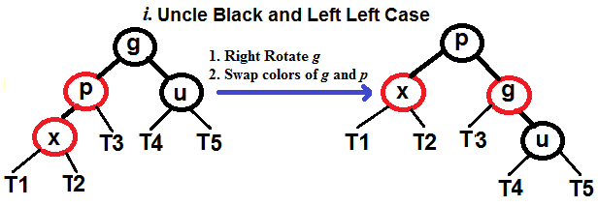
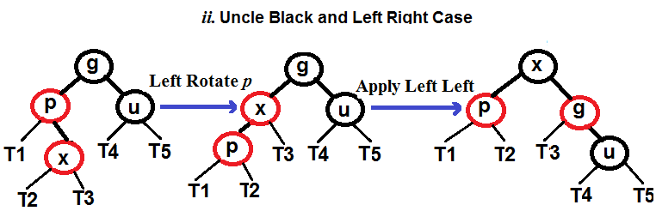
Red-Black Insertion Procedure (cont.)
Uncle is BLACK, Parent is Left Child of Grandparent

Slide 9
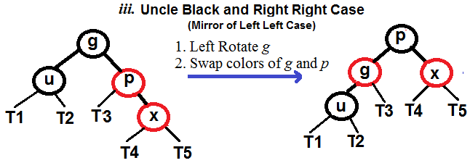
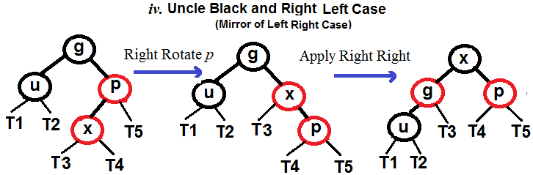
Red-Black Insertion Procedure (cont.)
Uncle is BLACK, Parent is Right Child of Grandparent

Slide 10
Insert Node to RBT Pseudo Code
FixUpAfterInsertion( x ):
1. Set color of x as RED
2. If x is not NULL & n is not Root & Parent of x is RED
2.1. Uncle of x is RED
2.1.1. Set color of Parent and Uncle as BLACK
2.1.2. Set color of GrandParent as RED
2.1.3. FixUpAfterInsertion(Grandparent of x )
2.2. Uncle of x is BLACK
2.2.1. If Left Left thus
2.2.1.1. Right Rotate GrandParent x
2.2.1.2. Swap color Grand Parent and Parent
2.2.2. If Left Right
2.2.2.1. Left Rotate Parent
2.2.2.2. Apply Left Left
2.2.3. If Right Right
2.2.3.1. Left Rotate Grandparent
2.2.3.2. Swap color Grand Parent and Parent
2.2.4. If Right Left
2.2.4.1. Right Rotate Parent
2.2.4.2. Apply Right Right
3. Set Color of Root as BLACK
Binary Search Tree Insertion( x ):
Search for a place to put a new node x.
Insert the new node to this place.
Fix up RB rules after insertion new node.

Slide 11

11
Based on Pseudo code above, create a function for insertion new node into Red-Black Tree.

Slide 12
To be continued…

